Slide 1
Echonlabs Pvt Ltd
UGC MIS Batch 8
Business Policy and Strategy
Group Assignment

Slide 2

Company Background

Slide 3
Vision
“Connect everyone to solutions that increase productivity and efficiency, through innovative solutions.”

Slide 4
Mission
“Provide low-cost premium solutions for businesses to build their online presence and to improve their workflow.”

Slide 5
Organizational values
Employee empowerment
Inspiring employees while giving freedom and authority to adapt and respond in real-time with solutions to deliver extraordinary results.
Knowledge sharing
Transformation of collective individual knowledge to organizational knowledge without the existence of orphaned knowledge and knowledge depreciation to result in the enrichment of organizational effectiveness.
Trust
Developing meaningful relationships to achieve tangible and intangible benefits to the organization.
Respect
Thinking Green, honour diversity and treat everyone with dignity in order to achieve growth and profitability.

Slide 6
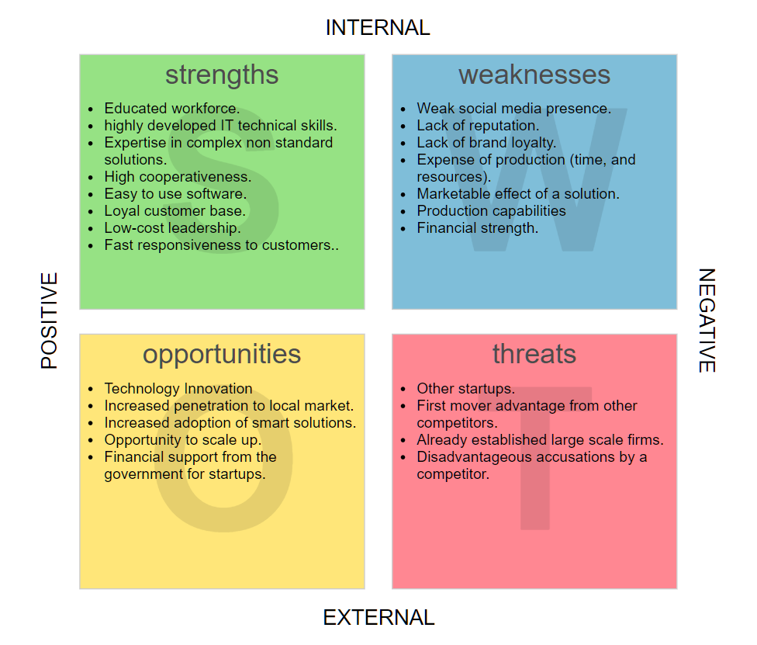
SWOT Analysis

Slide 7
SWOT Analysis
Strengths
Educated workforce.
highly developed IT technical skills.
Expertise in complex non standard solutions.
High cooperativeness.
Easy to use software.
Loyal customer base.
Low-cost leadership.
Fast responsiveness to customers.
Weaknesses
Weak social media presence.
Lack of reputation.
Lack of brand loyalty.
Expense of production (time, and resources).
Marketable effect of a solution.
Production capabilities
Financial strength.

Slide 8
SWOT Analysis
Opportunities
Technology Innovation
Increased penetration to local market.
Increased adoption of smart solutions.
Opportunity to scale up.
Financial support from the government for startups.
Threats
Other startups.
First mover advantage from other competitors.
Already established large scale firms.
Disadvantageous accusations by a competitor.

Slide 9
Strategic objectives
Innovation / Product Growth aligned with innovativeness
Launch 2 new innovative products by 1st May 2020
Launch / transition to a cloud service model by 1st March 2020
People / Culture aligned with respect and employee empowerment
Reduce staff attrition to less than 10% per annum by 1st Jan 2020
Win a Great Place to Work award by 31st Dec 2020
Processes / Operations aligned with innovativeness
Reduce product rejection rate to less than 2% by 1st Jan 2020
Implement a rigorous process of auditing our practises by 1st Jan 2020
Financial Growth aligned with employee empowerment
Grow gross revenue to 2 million LKR by 31st Dec 2020
Reduce net costs by 0.25 LKR million by 1st Nov 2020

Slide 10
Action Plan Functional Strategies
Launch 2 new innovative products by 1st May 2020
Scope
Identify latest organizational dashboard requirements and provide a customizable solutions
Establish formal relationships with reputed organizations
Studying requirements and suggesting the necessary dashboards
Launch / transition to a cloud service model by 1st March 2020
Scope
Identify the latest cloud technologies in all cloud partners (Azure, AWS, and GCP) and move our services as cloud based services.

Slide 11
Action Plan Functional Strategies Cont...
Reduce staff attrition to less than 10% per annum by 1st Jan 2020
Scope
Analyse reasons for attritions
Eliminate the causes
Retain valuable employees
Win a Great Place to Work award by 31st Dec 2020
Scope
Sign up with best places to work in Sri Lanka organization
Submit our organizational aspects
Successfully win a podium victory

Slide 12
Action Plan Functional Strategies Cont...
Reduce product rejection rate to less than 2% by 1st Jan 2020
Scope
Analyse causes for rejection such as inefficient solutions or unattractive product demos
Implement a rigorous process of auditing our practices by 1st Jan 2020
Scope
Implementing an organizational wide best practises guidelines for employees to follow

Slide 13
Action Plan Functional Strategies Cont...
Grow gross revenue to 2 million LKR by 31st Dec 2020
Scope
Analyse current gross revenue
Forecast gross revenue at the proposed data and change necessary constraints to meet the requirements (reduce additional costs)
Meeting requirements at the deadline
Reduce net costs by 0.25 million LKR by 1st Nov 2020
Scope
Analyse current expenditures
Apply proven methods to reduce costs such as energy efficient electrical equipment, green computing concepts and unnecessary resource consumption

Slide 14
Action Plan
Objective | Date of initiation/ Completion | Investment
Launch 2 new innovative products by 1st May 2020 | Start Date 1st April 2019 Complete Date 1st May 2020 | 500000 LKR
Launch / transition to a cloud service model by 1st March 2020 | Start Date 1st Jan 2020 Complete Date 1st March 2020 | 100000 LKR
Reduce staff attrition to less than 10% per annum by 1st Jan 2020 | Start Date 1st Jan 2019 Complete Date 1st Jan 2020 | 10000 LKR

Slide 15
Action Plan
Objective | Date of initiation/ Completion | Investment
Win a Great Place to Work award by 31st Dec 2020 | Start Date 31st Dec 2019 Complete Date 31st Dec 2020 | 8500 LKR
Reduce product rejection rate to less than 2% by 1st Jan 2020 | Start Date 1st Oct 2019 Complete Date 1st Jan 2020 | 15000 LKR
Implement a rigorous process of auditing our practises by 1st Jan 2020 | Start Date 1st Nov 2019 Complete Date 1st Jan 2020 | 25000 LKR

Slide 16
Action Plan
Objective | Date of initiation/ Completion | Investment
Grow gross revenue to 10 million LKR by 31st Dec 2020 | Start Date 1st Jan 2020 Complete Date 31st Dec 2020 | 100000 LKR
Reduce net costs by 3.85 million LKR by 1st Nov 2020 | Start Date 1st Jan 2020 Complete Date 1st Nov 2020 | 50000 LKR

Slide 17
HR Plan
Launch 2 new innovative products by 1st May 2020
Resources
Business Analysts, business development consultants
Project Manager
R&D Manager, Sales and Marketing manager
Launch / transition to a cloud service model by 1st March 2020
Resources
Cloud Developers
Project Manager
Development and Delivery Manager
Reduce staff attrition to less than 10% per annum by 1st Jan 2020
Resources
HR Employees
Project Manager
HR Manager
Win a Great Place to Work award by 31st Dec 2020
Resources
-
Project Manager
Sales and Marketing Manager

Slide 18
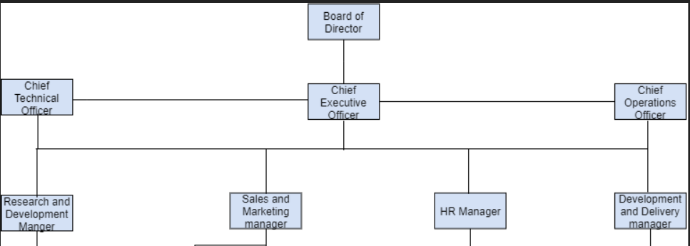
HR Plan

Slide 19
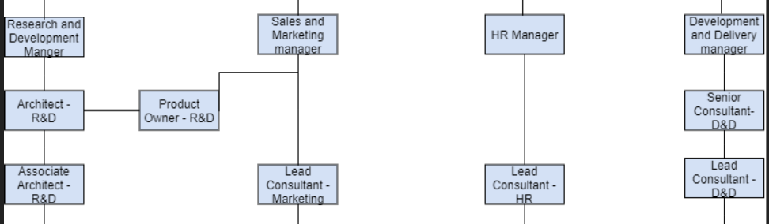
HR Plan

Slide 20
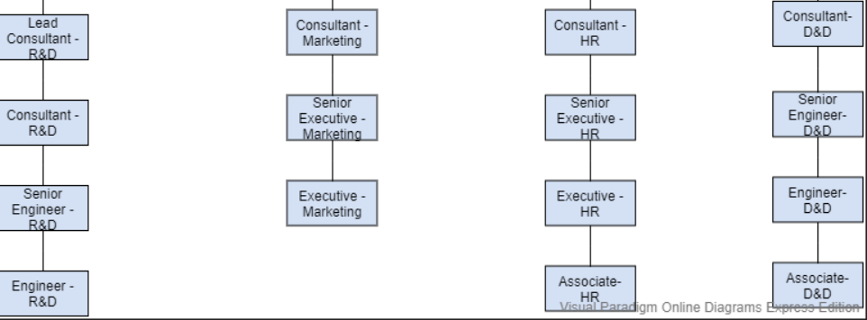
HR Plan

Slide 21
HR Plan Contd...
Reduce product rejection rate to less than 2% by 1st Jan 2020
Resources
CTO, R&D Manager, Sales and Marketing Manager
Project Manager
CTO, R&D Manager, Sales and Marketing Manager
Implement a rigorous process of auditing our practices by 1st Jan 2020
Resources
Board of Directors
Project Manager
-
Grow gross revenue to 2 million LKR by 31st Dec 2020
Resources
CEO, COO
Project Manager
CEO
Reduce net costs by 0.25 million LKR by 1st Nov 2020
Resources
CEO
Project Manager
CEO

Slide 22
Thank you!!!
10009257 Karavita, K V Vishmi D
10009240 Priyamali, G Darshi
10009234 Kandage,K D Nethmini R
10009046 Jayaweera, W A H M Lakshika R
10001466 Kaushalya, P H Buddhi
10009249 Senadheera, S A Saroj

